Slide 2
Proposal to relocate Gartcosh Primary School to a new site

Slide 5
GARTCOSH PRIMARY
The Council is proposing through the Town and Community Hub programme, a new build Gartcosh Primary School, located between Woodneuk Avenue and Johnstone Road.
Proposal recommendations:
1. To improve approaches to safeguarding, child protection and children’s rights.
To develop self - evaluation practice to ensure that staff understood what was needed to improve outcomes for children.
To implement high quality individualised teaching and learning approaches that meets the needs of children.
To improve how staff assess the progress of children and how to use the information to support progress.

Slide 6
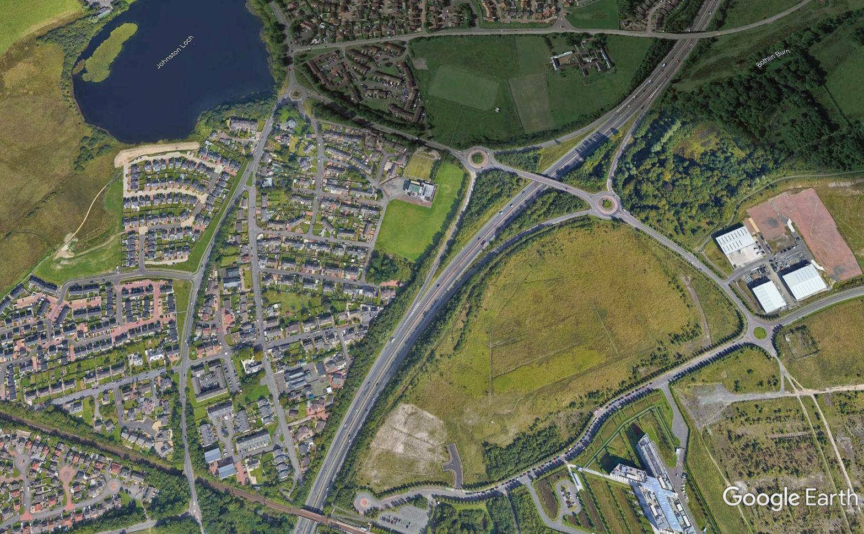
PROPOSED SITE
Proposed Site
Existing School Site

Slide 7
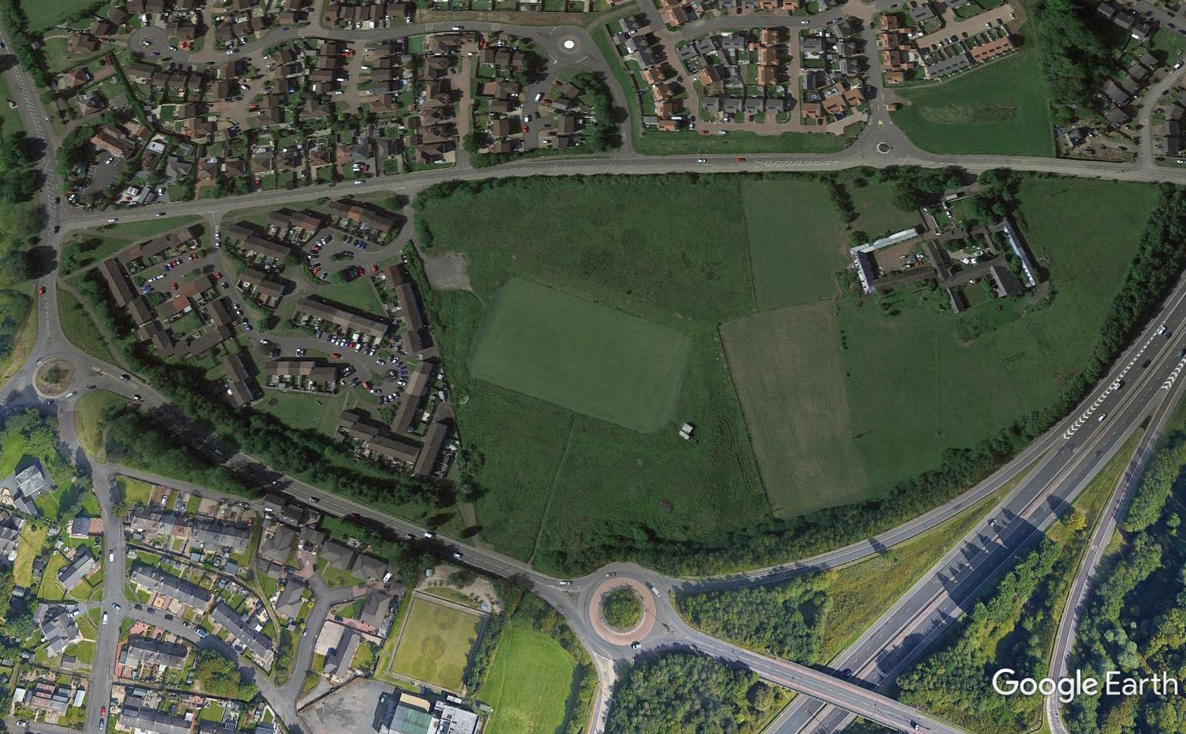
PROPOSED SITE

Slide 8
PROPOSED PROVISION
PRIMARY SCHOOL – Replacement for Gartcosh PS
EARLY YEARS – New provision
ASN – New provision
Community Provision – Replace Gartcosh CC

Slide 9
PROCESS AND ANTICIPATED TIMESCALE
Appoint Design Team & Main Contractor
Includes
“Intelligent Brief”
Phase
Design Phase – approximately 18 months
Build Phase – approximately 18 months

Slide 10
INTELLIGENT BRIEF
Focus is on stakeholder engagement:
Understand the needs which can be incorporated into the design.
It’s about stakeholders being more descriptive than prescriptive.
Stakeholders include:
School community: Pupils; Parents; Staff
Wider community: Identified by Communities Team

Slide 11
ALTERNATIVE SITE USE

Slide 12
Q&A
Gartcoshconsultation@northlan.gov.uk

