Slide 2
Proposal to relocate Mavisbank School
to the existing Carnbroe Primary School

Slide 3
THE STRATEGIC RECONFIGURATION OF INTENSIVE SYSTEMS AND SERVICES - RATIONALE
In September 2019, the Education and Families Committee approved a review of Additional Support Needs services which established twelve key recommendations for action.
Recommendation 8: ‘Partnership working will be strengthened in a revised Support Around the School model, which will enable greater empowerment of staff to meet the needs of young people and enable a greater connection between needs and the partnership response to them. A more holistic approach to supporting families will underpin this.’
Recommendation 11: ‘A clear plan for the future of the ASN estate, which creates Cluster ASN Hubs and specialist provision around the envisaged campus model of the future will be established as part of the Community Investment Fund and developed as part of the ongoing work to prioritise community hub investment proposals.’

Slide 5
MAVISBANK SCHOOL
The historic ASN estate provision of North Lanarkshire has meant that there are a number of smaller, more isolated ASN schools which can be more susceptible to staffing shortages and therefore less sustainable as a result. Consideration has been given to developing existing establishments to more modern campus facilities.
Proposal recommendations:
1. To improve approaches to safeguarding, child protection and children’s rights.
2. To develop self - evaluation practice to ensure that staff understood what was needed to improve outcomes for children.
To implement high quality individualised teaching and learning approaches that meets the needs of children.
To improve how staff assess the progress of children and how to use the information to support progress.

Slide 6
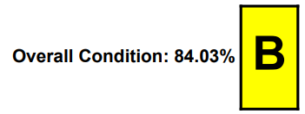
BUILDING CONDITION STATEMENT
Mavisbank School
Carnbroe Primary School
Notes:
To establish a Condition Rating ‘A’ the building requires upgraded windows and a new reception/entrance…this will increase the condition of the building circa £60k

Slide 7
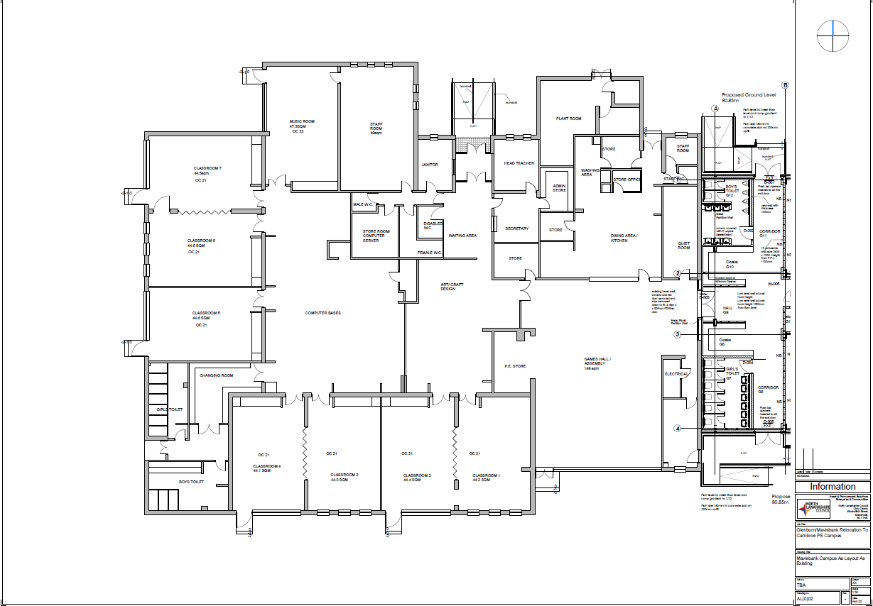
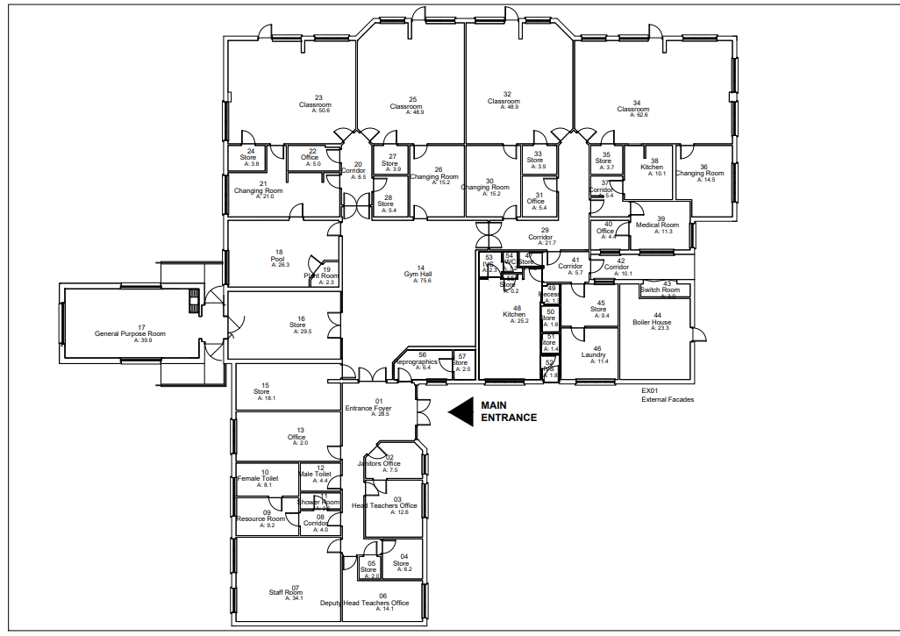
EXISTING MAVISBANK SITE

Slide 8
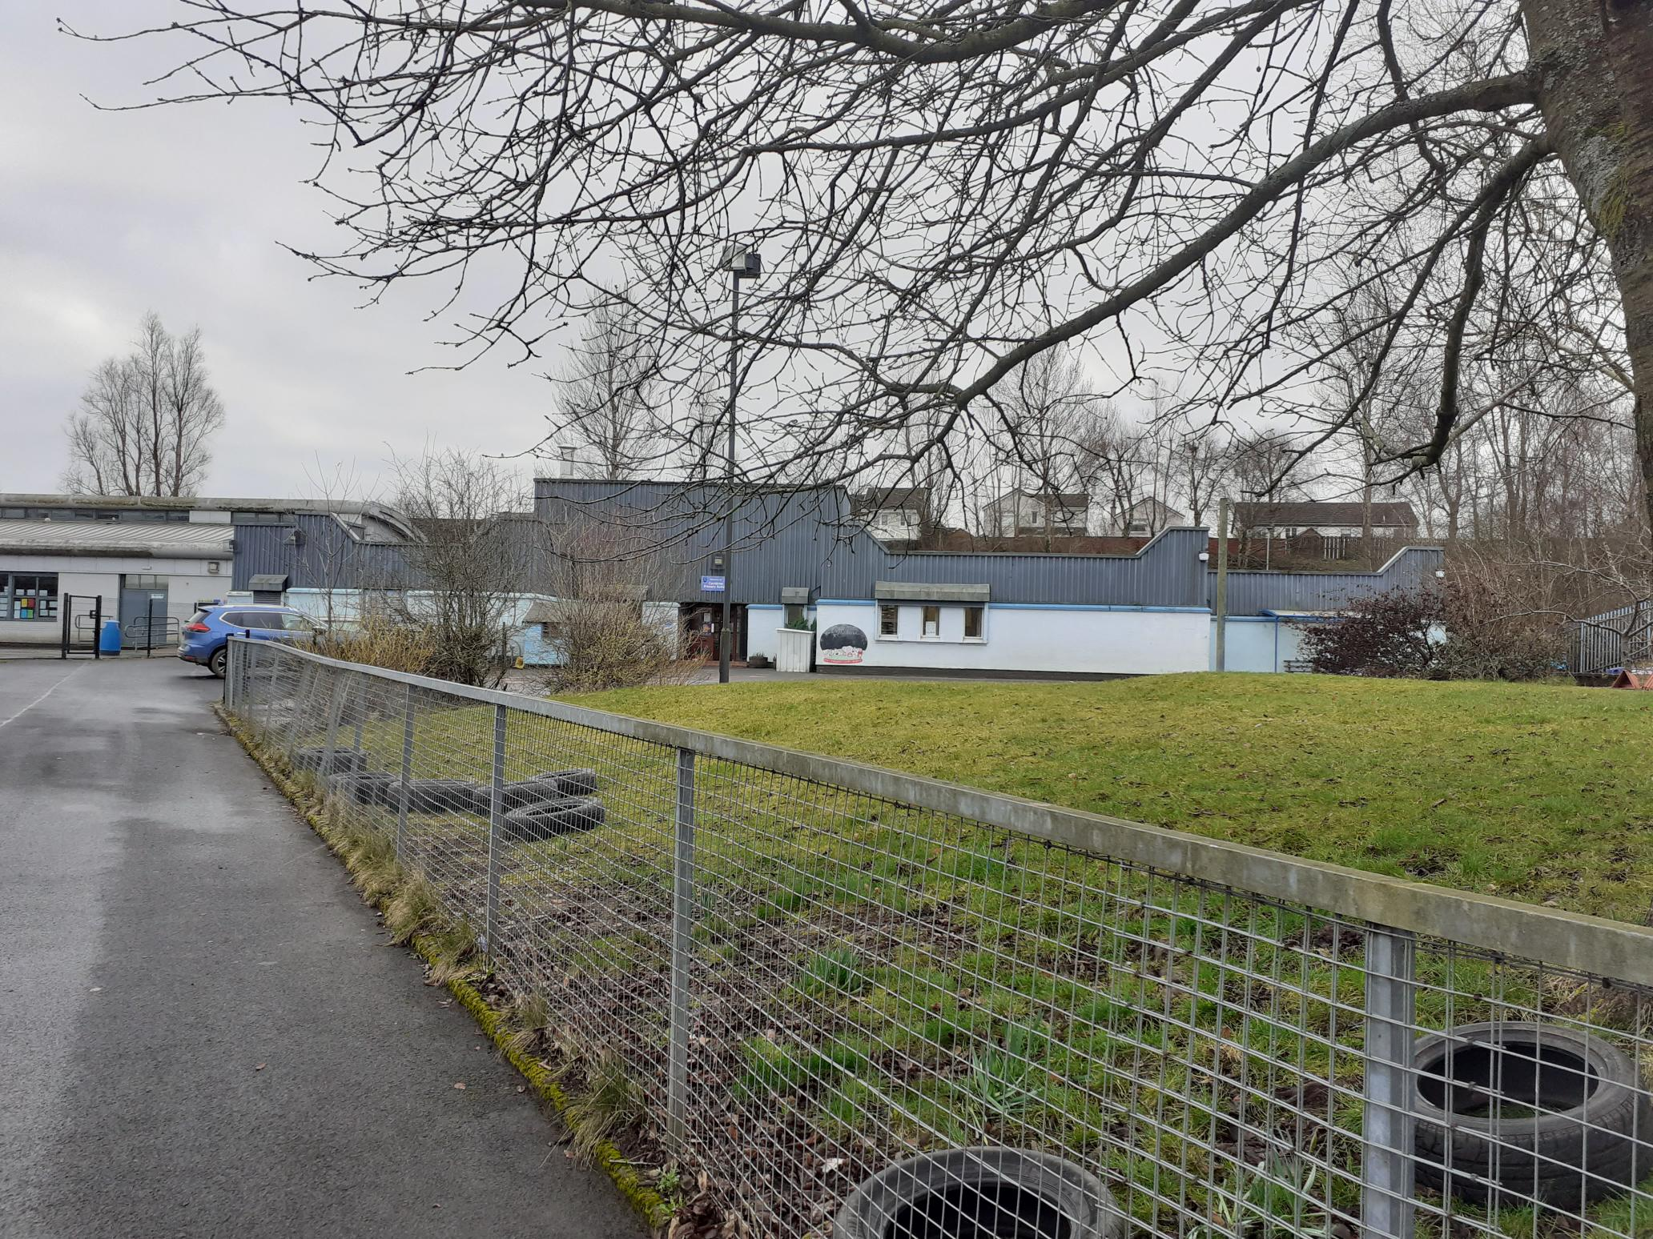
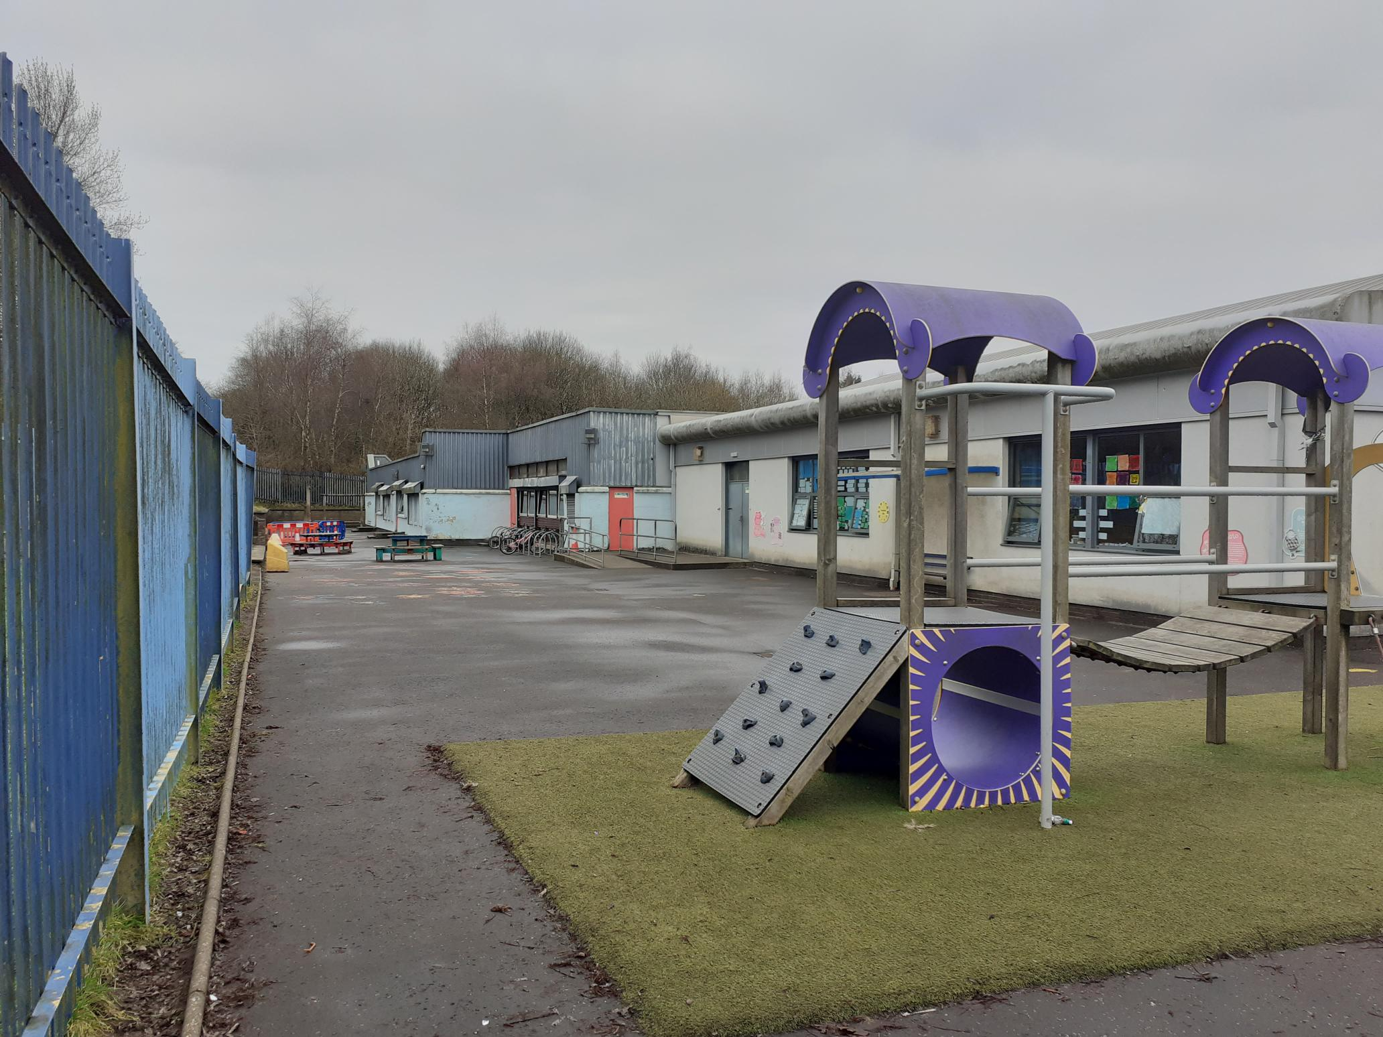
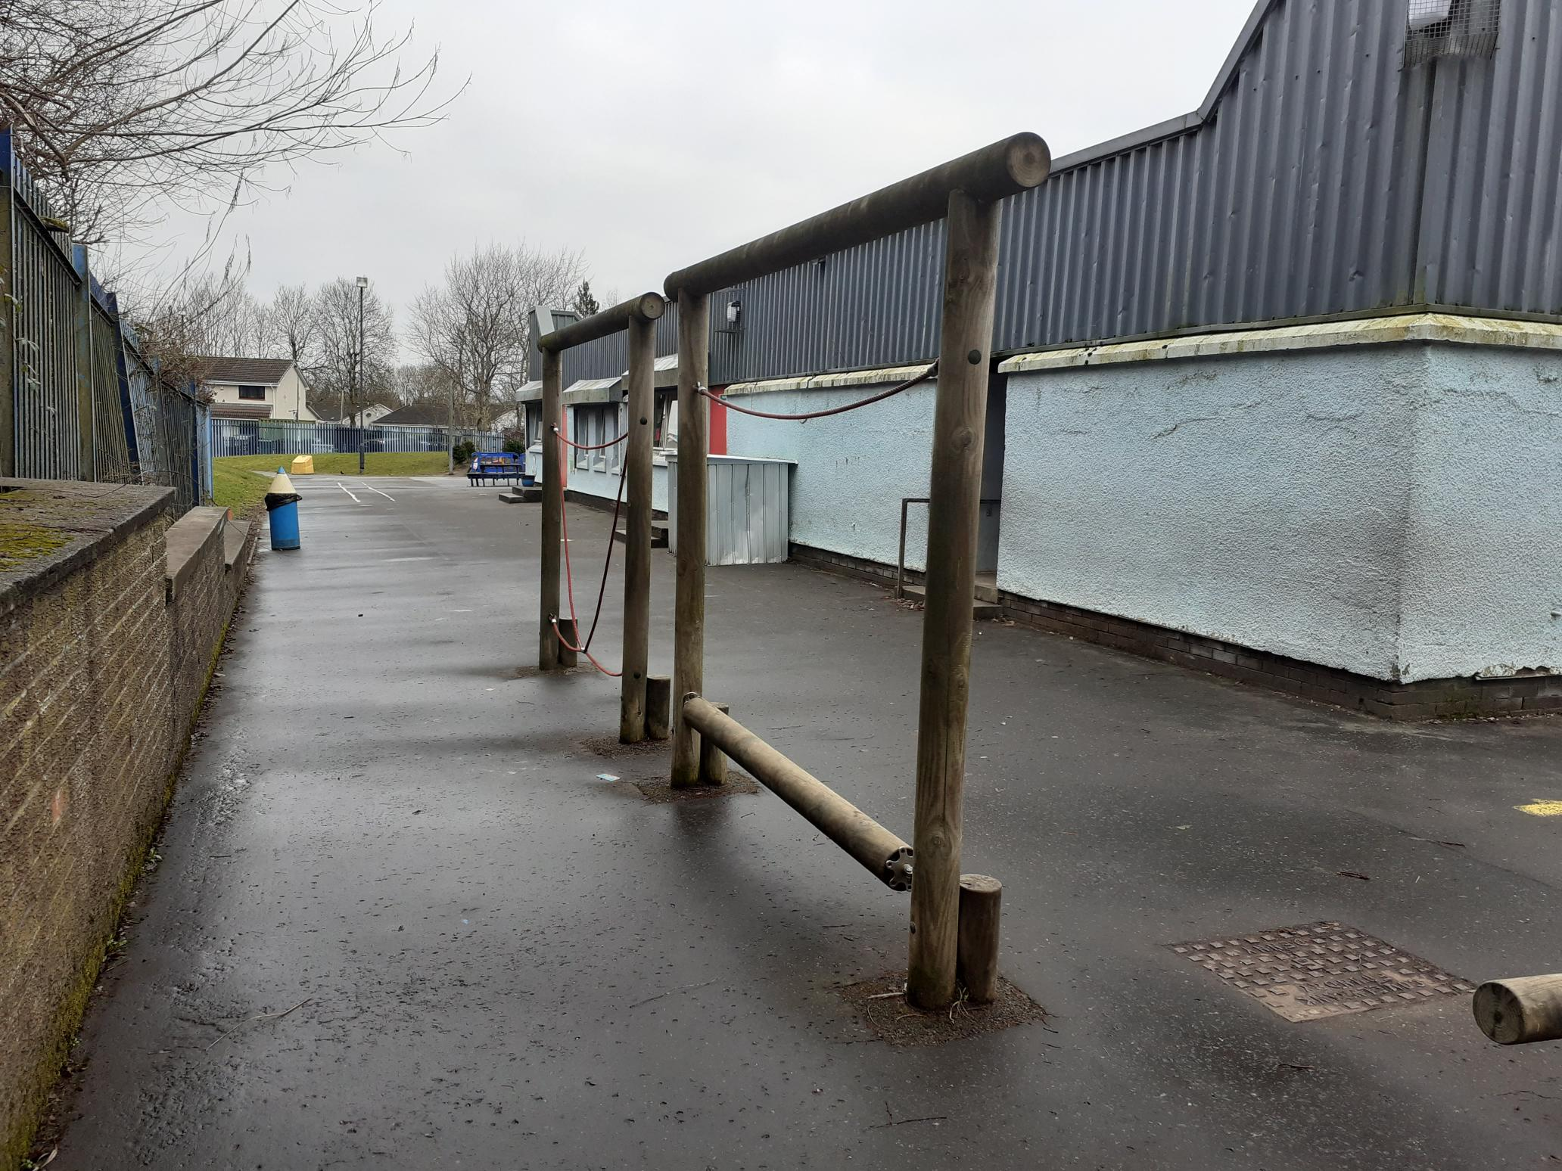
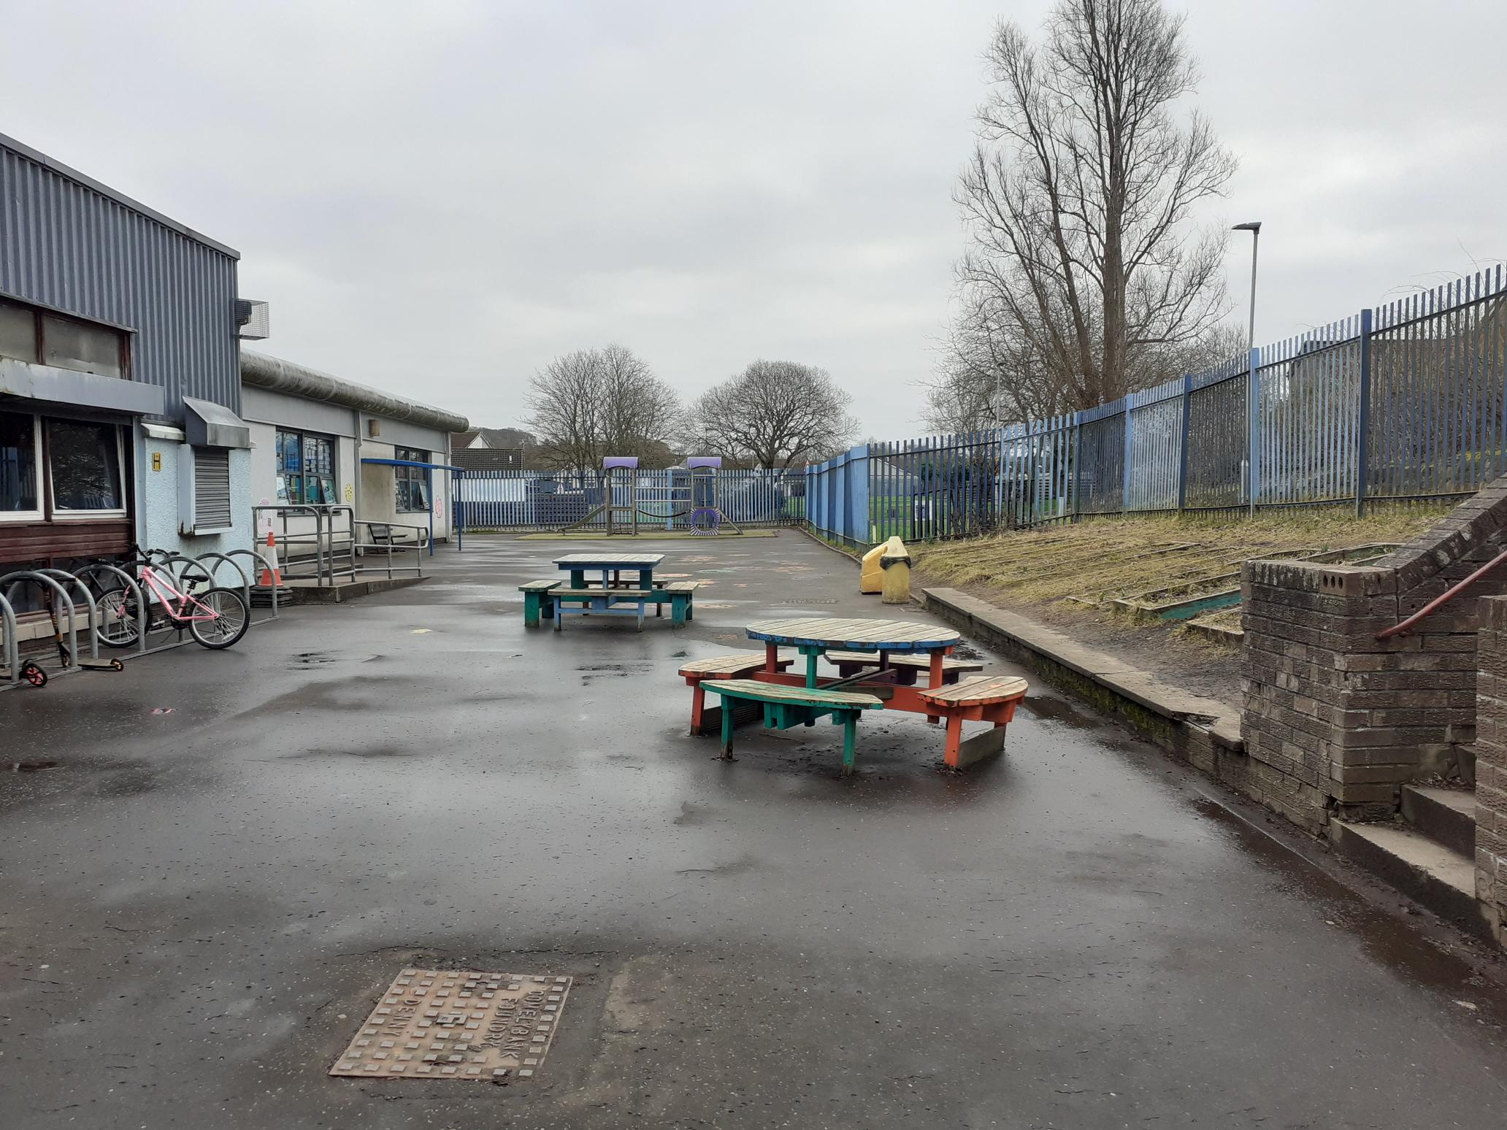
CARNBROE PRIMARY SCHOOL

Slide 9
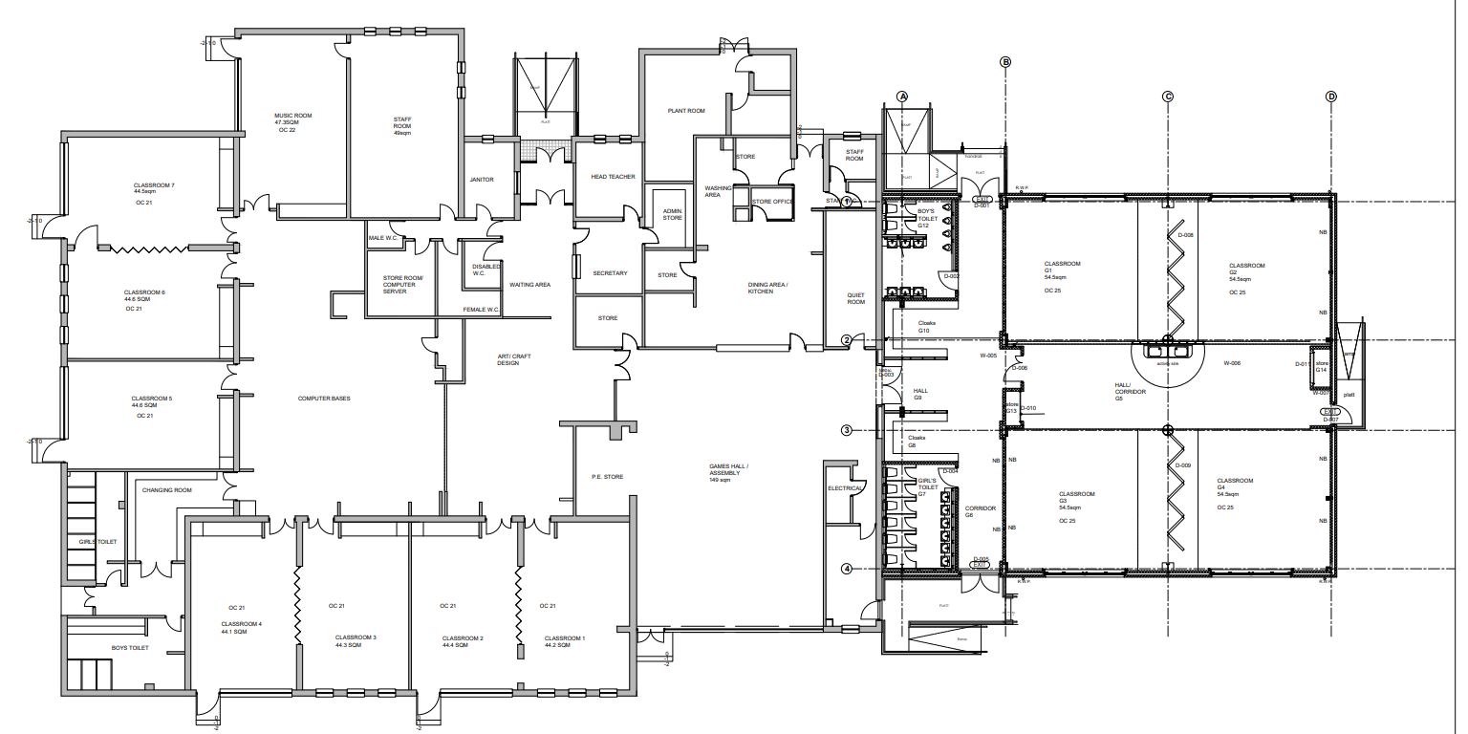
CARNBROE PRIMARY EXISTING PLAN

Slide 10
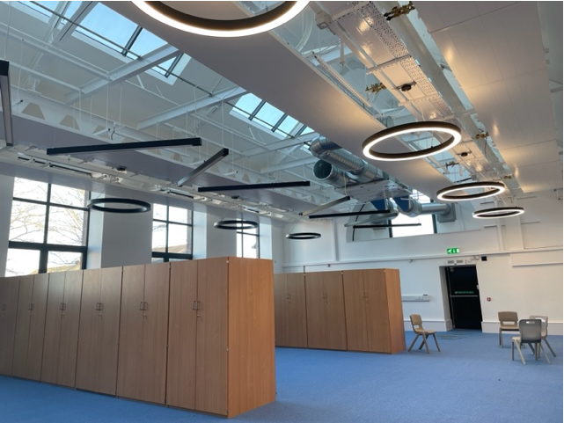
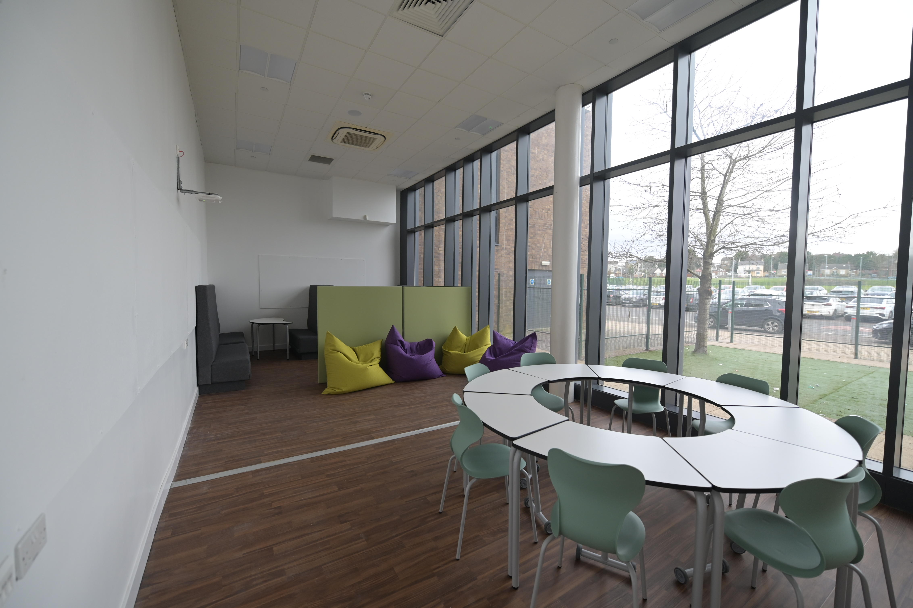
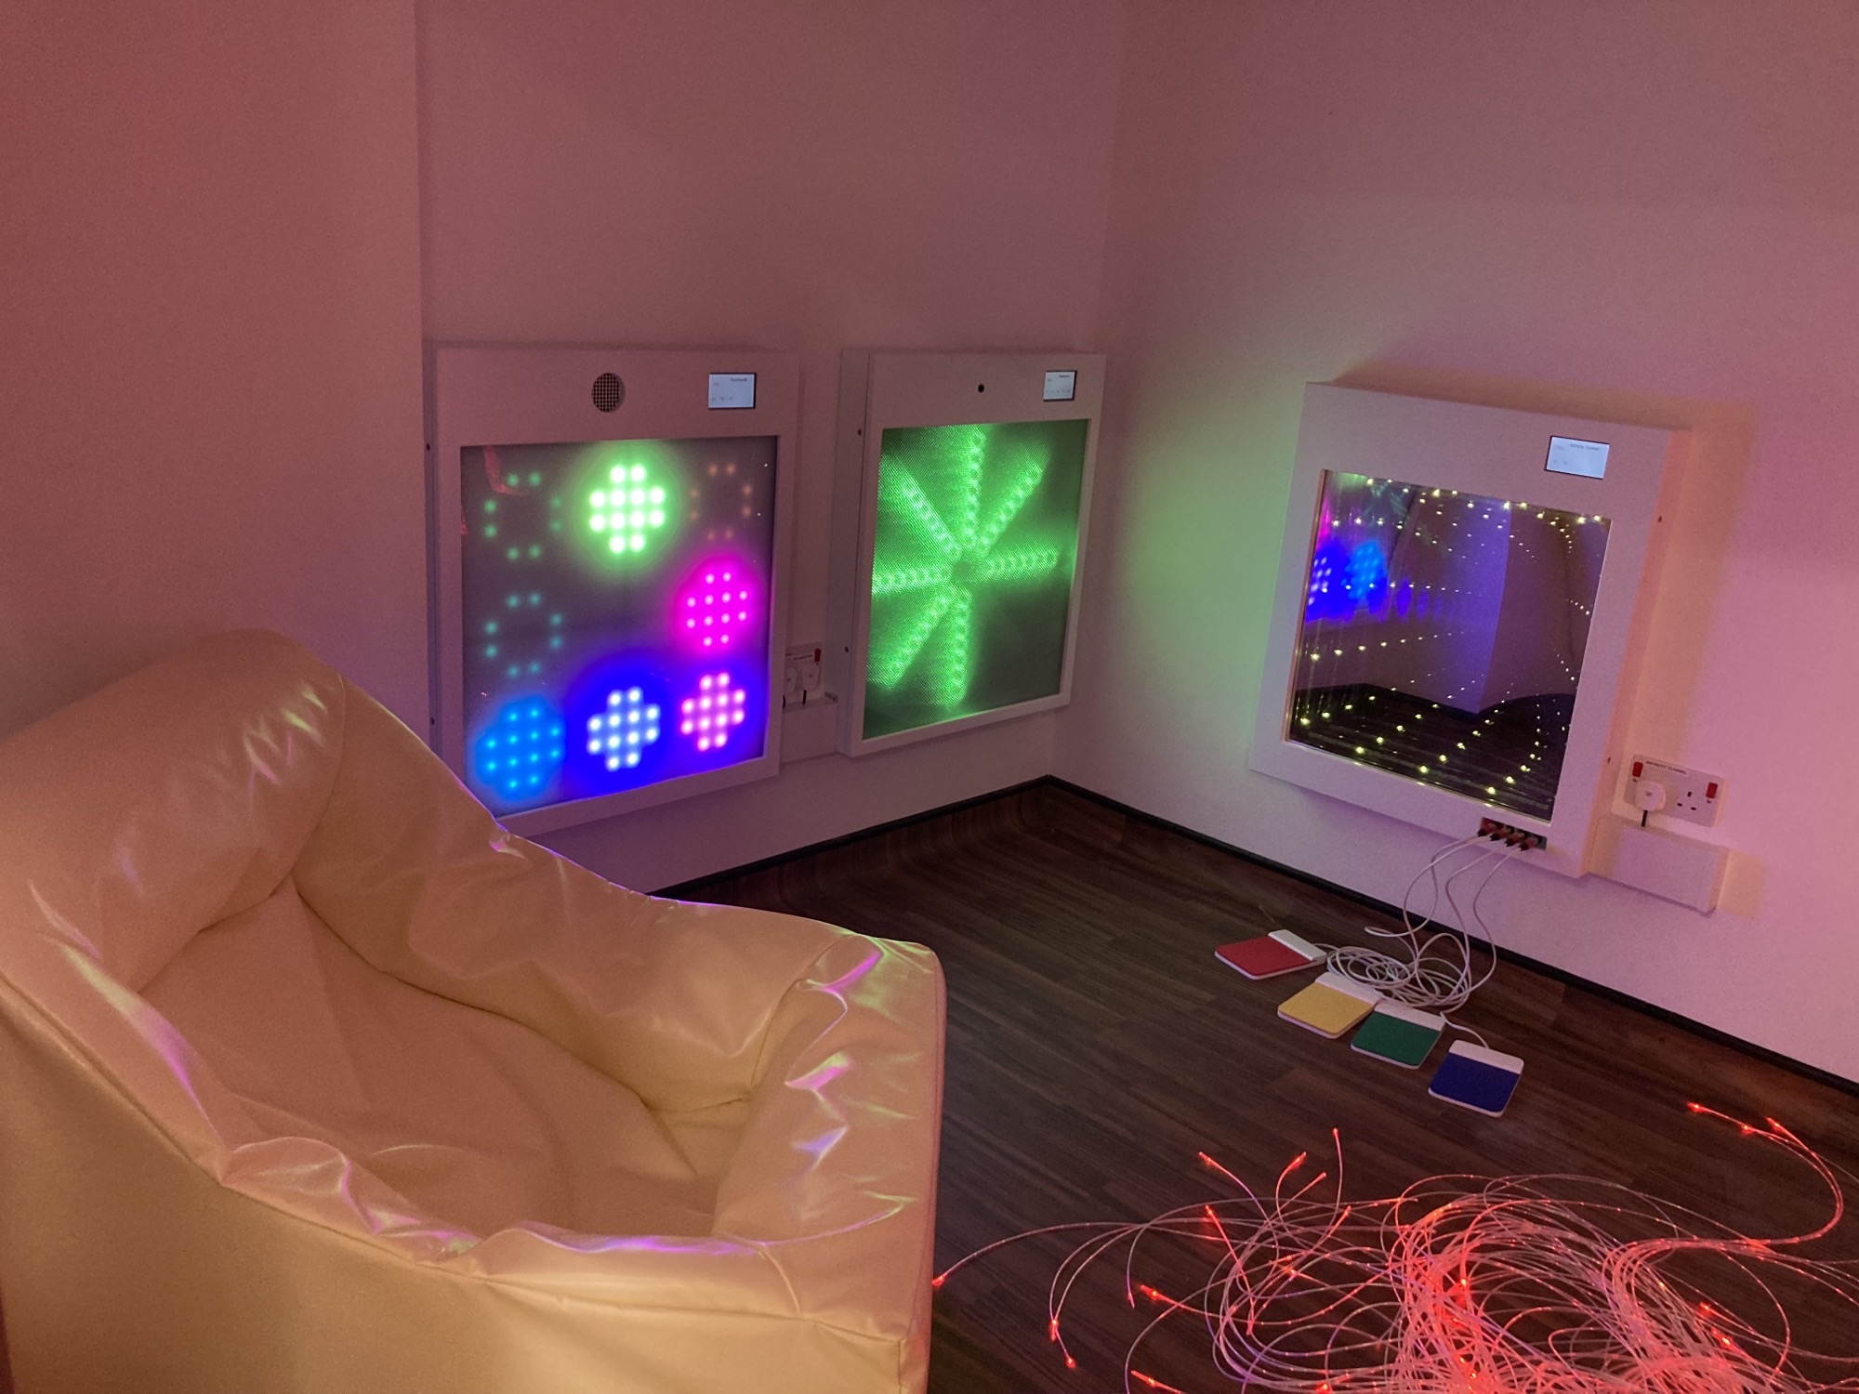
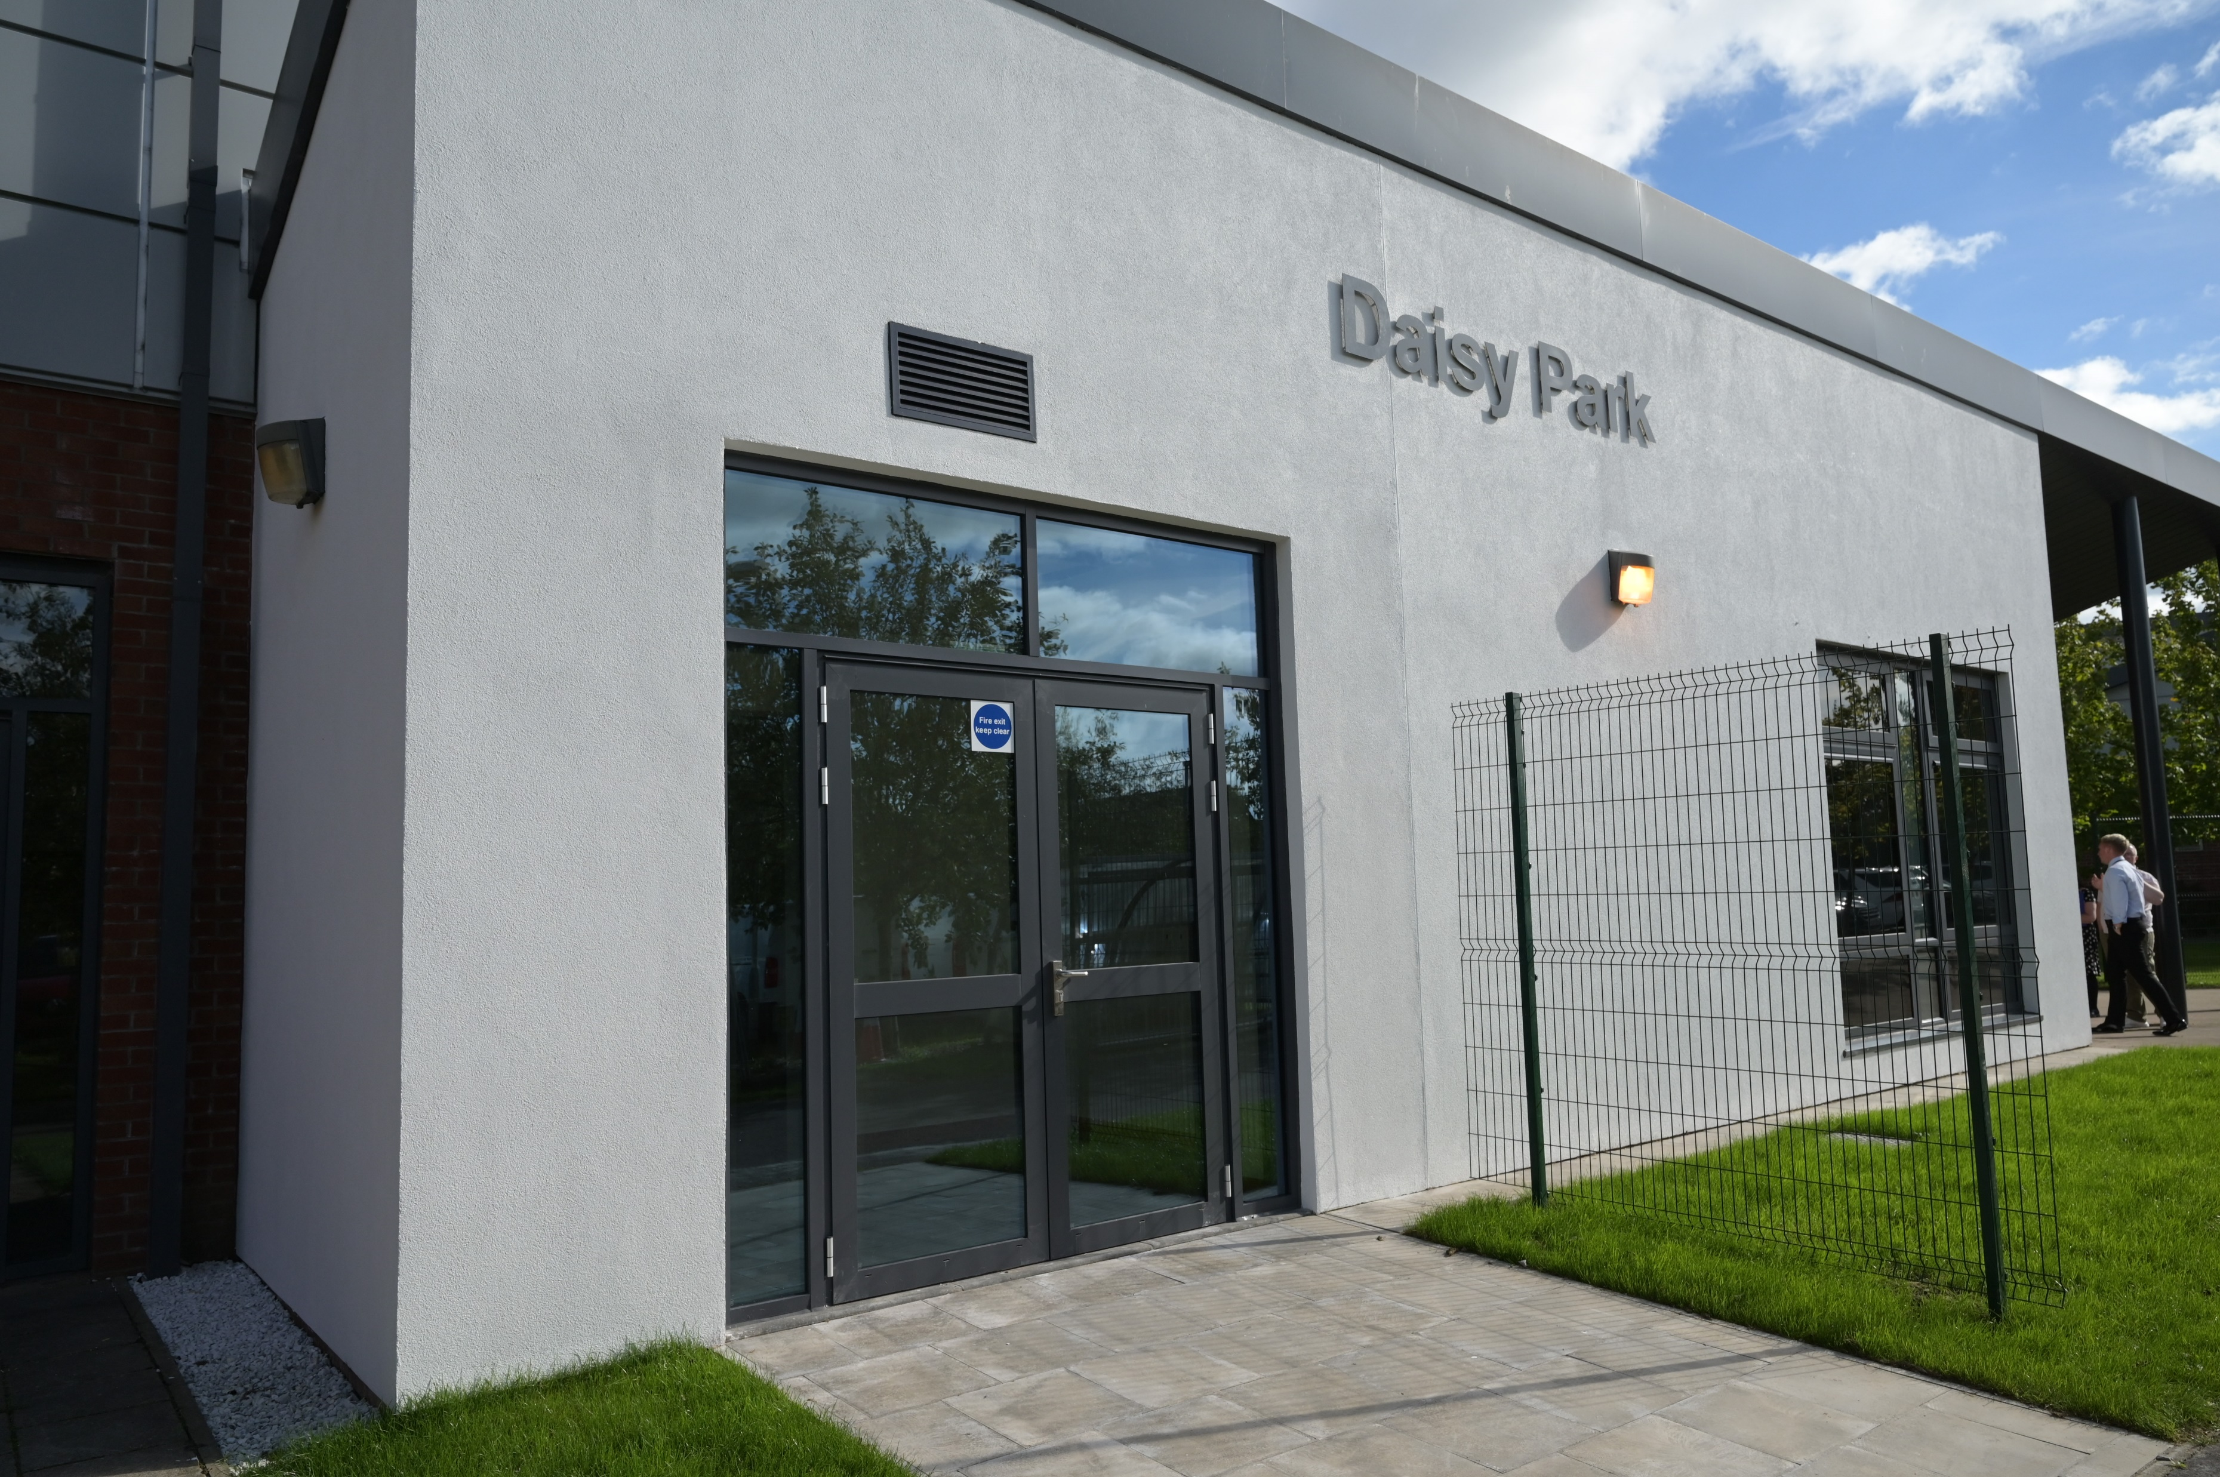
PREVIOUS PROJECTS

Slide 11
OPTIONS
Pathways, Packages
Partnerships
Carnbroe Site
Catering
Counselling Services
Rural Skills
Sport Interventions
Digital Classroom
Skills Academy
Mainstream School

Slide 12
VOCATIONAL INTERVENTIONS
Pathways, Packages
Partnerships
Coltness High
Automotive
LAGTA
Lanarkshire Catering School
Construction Skills Academy
Counselling Services
Rural Skills
Sport Interventions
Early Education & Childcare
New College Lanarkshire
Glasgow Kelvin College
Skills Academy

Slide 13
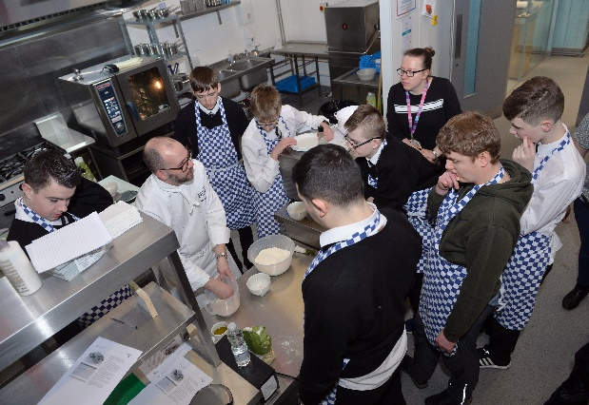
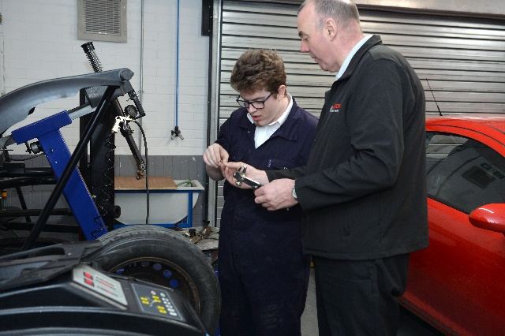
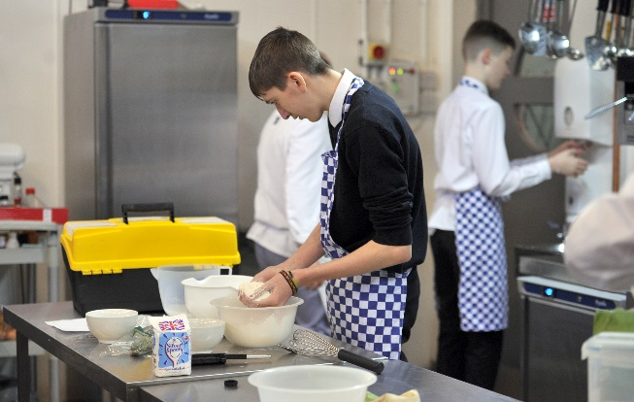
WE ASPIRE
Pathways
Packages
Partnerships

Slide 14
RECONFIGURING ASN SYSTEMS AND SERVICES
Phase 1 – Sep 2023
Phase 2 – from
Oct 2023
Phase 4 – by
Jan 2024
Phase 3 – from
Oct 2023
INDICATIVE TIMELINE
Reconfigured Arrangements Complete
Transition Planning
& Implementation
Capital Implementation
Elected Member Approval:
Capital Funding Approved
Mobilisation Project Works

Slide 15
VOCATIONAL EDUCATION
Notes:
North Lanarkshire Council’s Vocational Education Programme differs from most LA’s…as with it’s commitment to in-school delivery & capital funding for ‘fit for purpose’ vocational classes.
NLC Pre-Lockdown was the largest provider of in-school Voc Ed (including what we would term as Traditional Voc Ed, now FA’s 12 Frameworks and Pre-FA’s within our establishments.
We have established a comprehensive, capital structured, accessible curriculum meeting the needs of ASN pupils …the intention is to expand the delivery model to a more Vocational in-school model for SEBN pupils.
This is a mixed-mode delivery model, incorporating traditional subject delivery linked to Voc Ed- with Work-related learning (not simulated) this opens the opps for industry recognised qualifications
With 19 Vocational areas across the ASN, one of the key focuses within Education & Families is to increase the number of Skills Academies across the school estate inline with NLC One-Plan

Slide 16
Q&A

