Slide 1



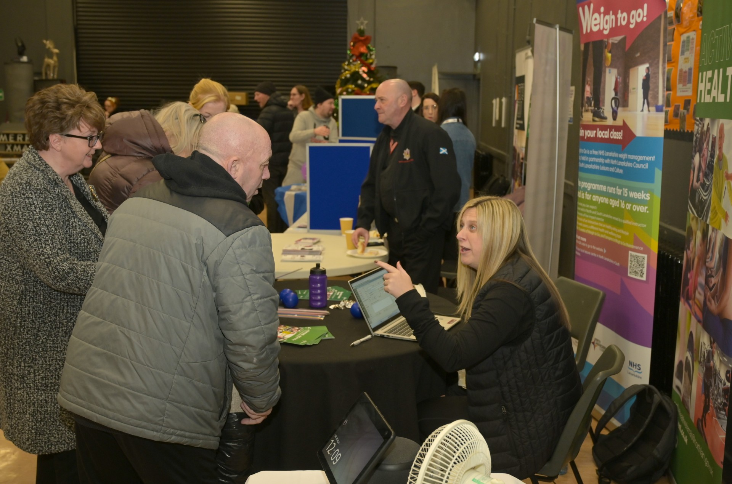
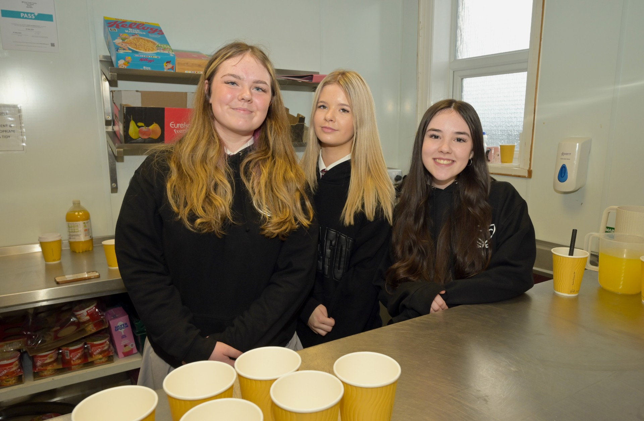
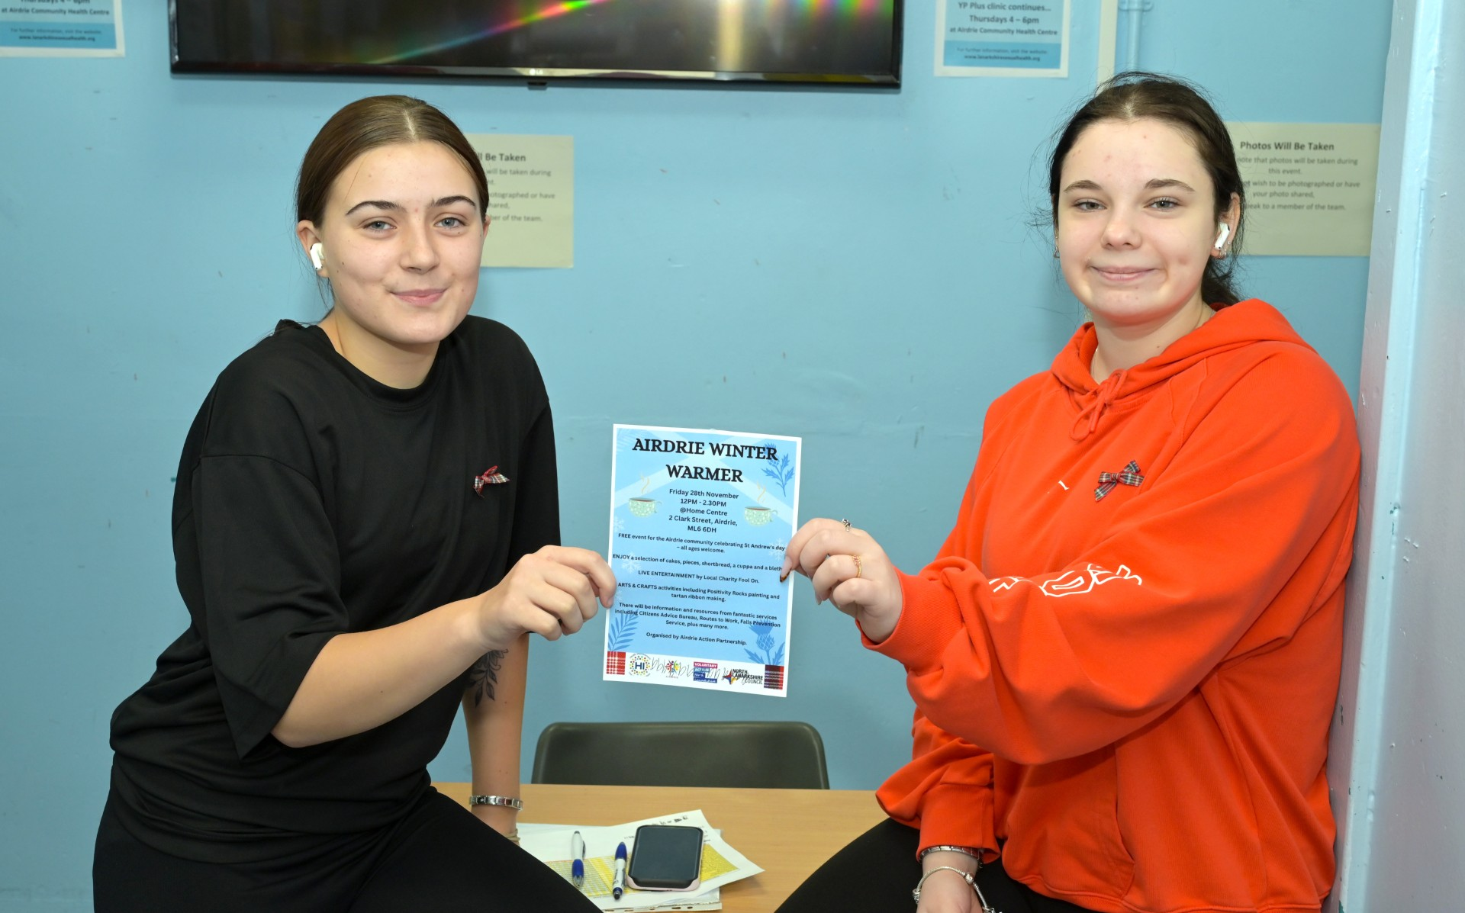
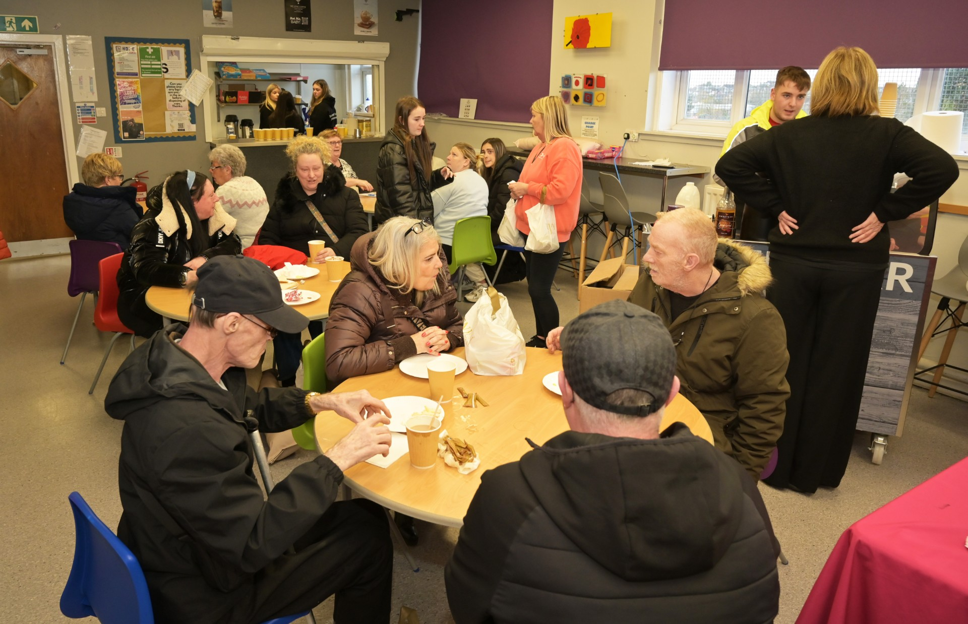
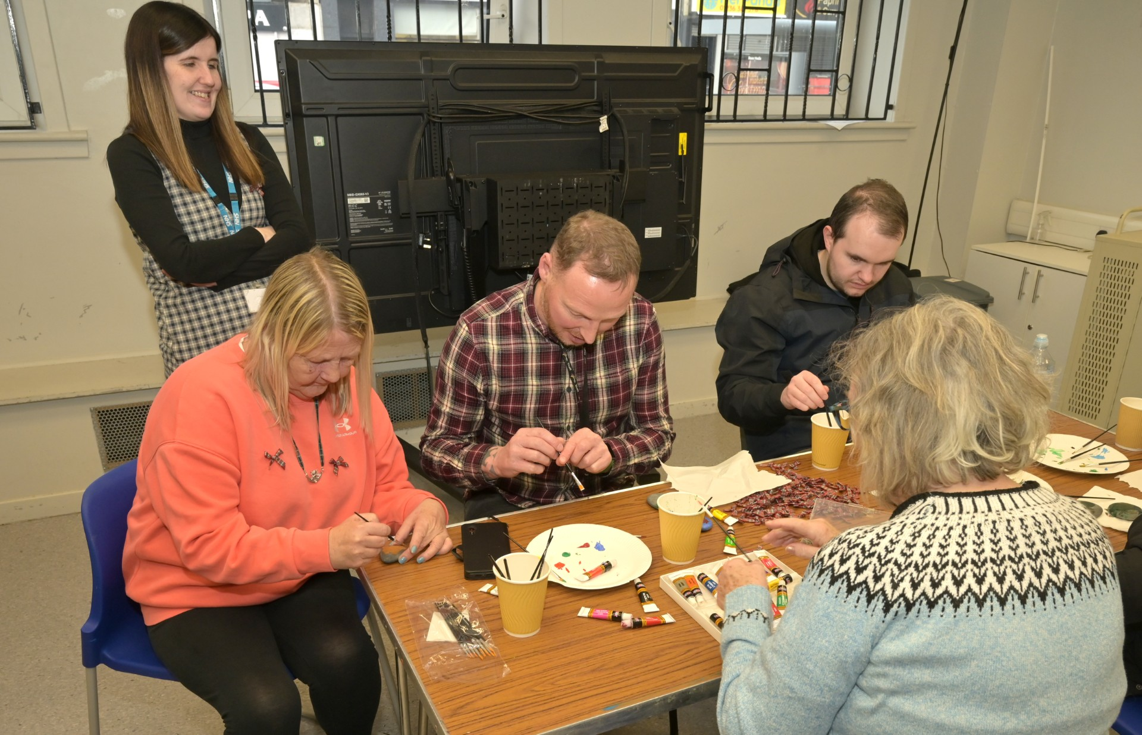
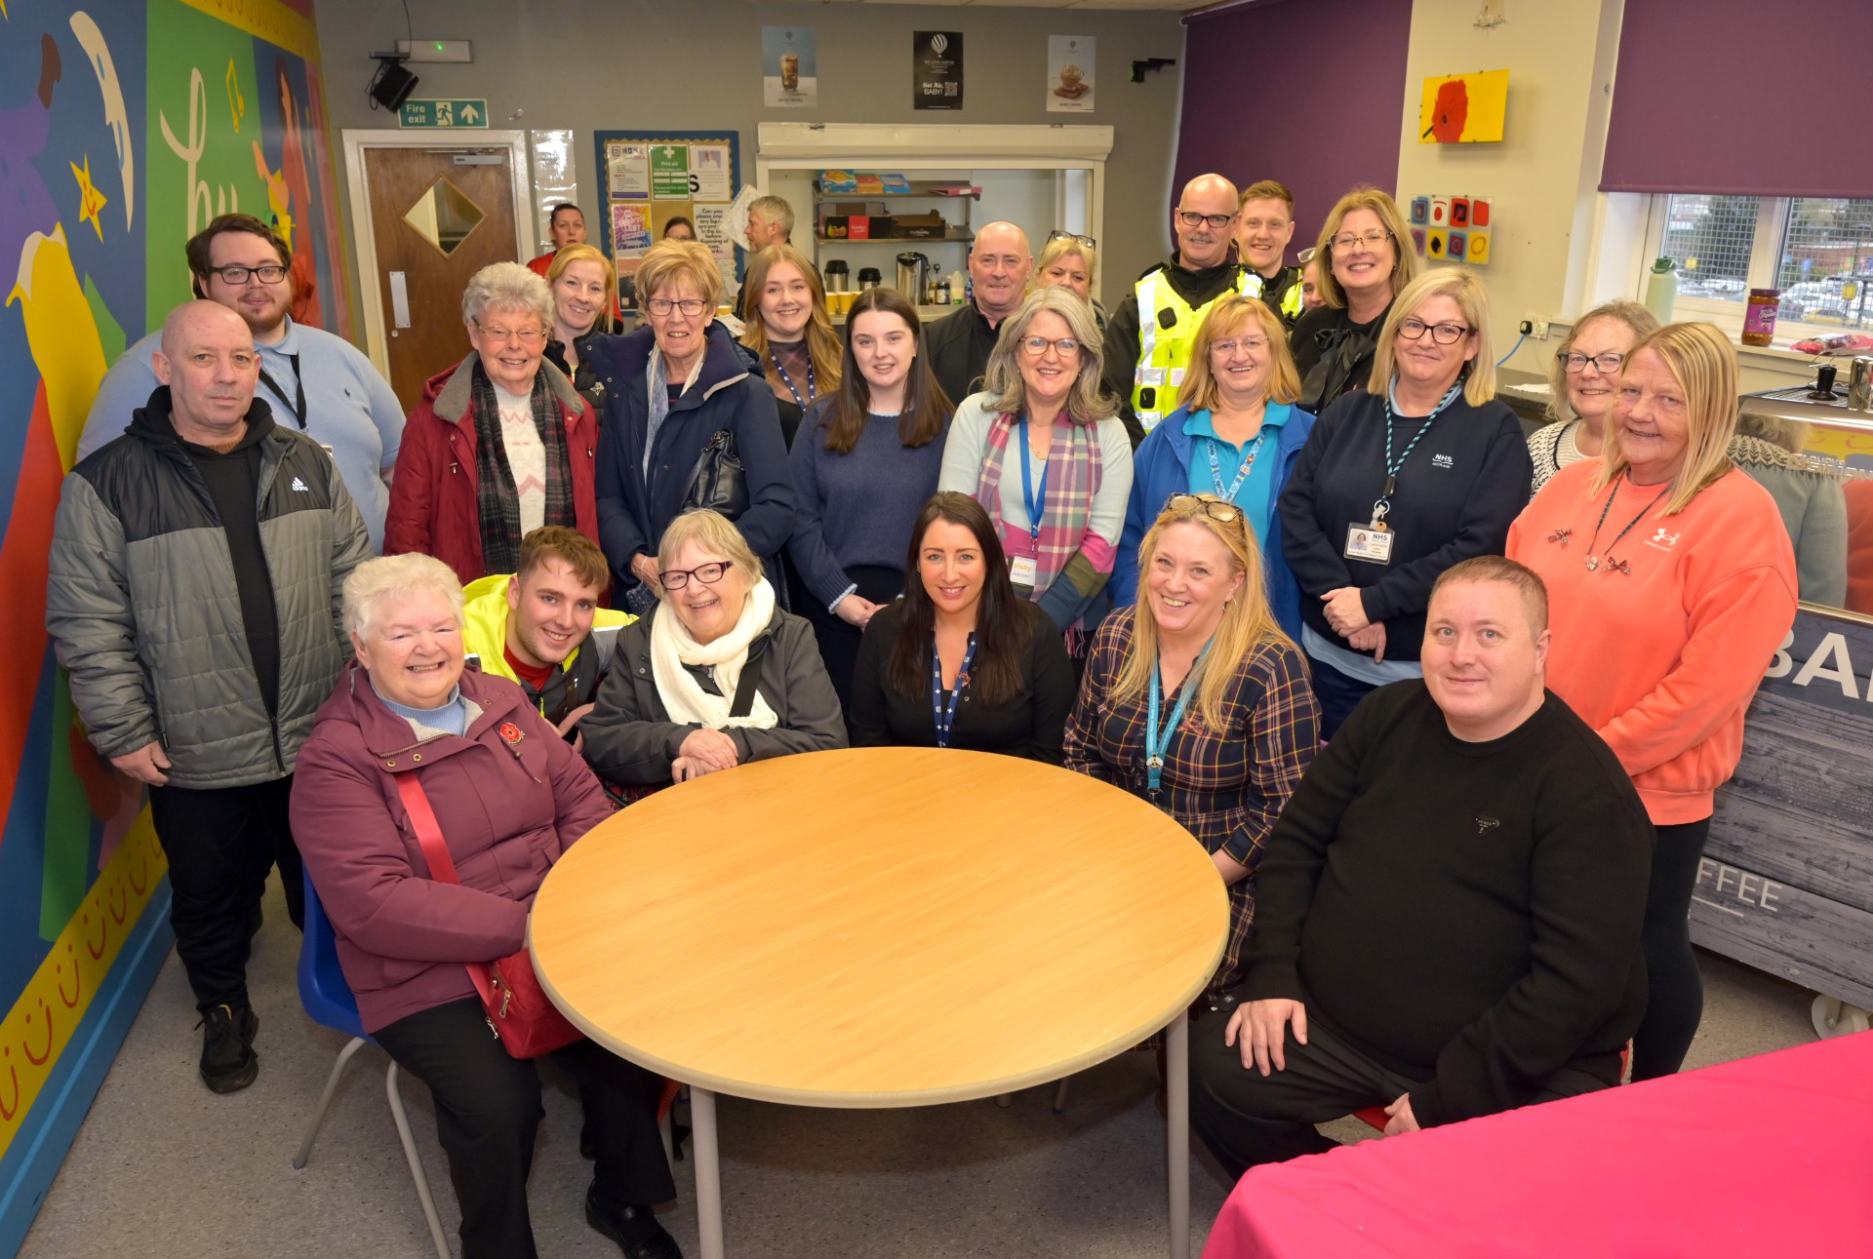
Airdrie Action Partnership
Winter Warmer St Andrews Day Event November 2025
We work in partnership to…
Address the Local Outcome Improvement Plan Priorities of Poverty & Mental Health and Wellbeing
Winter Warmer
Outcomes
St Andrew’s Day Winter Warmer Event Held on 28th November 25 in the @Home Centre in Airdrie. Participants had the opportunity to visit a range of services such as CABIA, Airdrie Adult Learners Forum, Citizen’s Advice Bureau, Routes to Work amongst many others. Participants enjoyed Scottish afternoon tea and were offered free period products, draught excluders and soup packs to take away with them.
18 Stall holders attended on the day with a range of information.
Stall holders reported many positive outcomes of the event with both CABIA & CAB reporting they gained new clients/service users that were previously unknown to their organisation.
Over 65 local residents received information, an opportunity to take part In arts & crafts, afternoon tea and a soup pack.
Airdrie Action Partnership Community Events Survey carried out on the day with attendees.
10 Young people gained hours towards their Saltire award & 3 young people received their SQA in assisting with preparing an event.
Next Steps
Feedback from participants and stall holders will be collated and will inform future activities. Airdrie Action Partnership’s Community Events Survey will remain open for those unable to attend the event. The data from this survey will inform the community events programme that AAP will deliver in 2026 utilising grant funding secured from the Scottish Procurement Alliance .
Arts & Crafts
Participants on the day were invited to take part in Arts & Crafts Activities which included creating St Andrews Day Ribbon Pins and ‘Positivity Rocks’- rocks, paints and positive affirmations were all available to people to create a positive message to take away with them.

